Slide 1

FIFA 19 data analysis
DETAILED PROJECT REPORT

Slide 2
Project details:
Project Title | FIFA 19 DATA ANALYSIS
Technologies | Business Intelligence
Domain | Sports
Difficulties level | Advanced

Slide 3
Objective: My primary goal is to conduct a thorough analysis of the FIFA 19 player dataset, focusing on key metrics and factors that contribute to player performance. By exploring the relationships between attributes such as Acceleration, Sprint Speed, Agility, and more, we aim to uncover valuable insights into the dynamics of player capabilities and playing styles. Through meticulous examination and statistical analysis, I seek to identify patterns, trends, and correlations within the dataset that offer deeper insights into player performance. Ultimately, our findings will contribute to a better understanding of the factors that influence player success in the virtual football world of FIFA 19.

Slide 4
Problem Statement:
In this data analysis project, My objective is to delve into the rich tapestry of player attributes encapsulated within the latest edition of the FIFA 19 database. The dataset comprises detailed information for each registered player, spanning a wide array of metrics such as Age, Nationality, Overall Rating, Potential, Club, and more. This dataset serves as a comprehensive repository of football player statistics, offering insights into various facets of their gameplay and characteristics.

Slide 5
Dataset information: The Dataset contains only one datafile. It contains information like Player Information The dataset contains comprehensive player information, including details such as age, nationality, overall rating, potential rating, club affiliation, market value, wage, preferred foot, international reputation, and skill moves. Additionally, it includes data on work rate, player position, jersey number, joining date, loan status, and contract validity. Physical attributes like height and weight are also provided, offering a holistic view of each player's profile.

Slide 6
Player Attributes In-depth player attributes are recorded for various positions on the field, covering offensive, midfield, defensive, and goalkeeping roles. These attributes include specific ratings for striking abilities (LS, ST, RS, LW, LF, CF, RF, RW), midfield play (LAM, CAM, RAM, LM, LCM, CM, RCM, RM), defensive capabilities (LWB, LDM, CDM, RDM, RWB, LB, LCB, CB, RCB, RB), and goalkeeping skills (GK). Each attribute provides insight into a player's technical proficiency, tactical versatility, and role suitability within different team formations.

Slide 7
Player Skills and Attributes A comprehensive set of player skills and attributes are meticulously documented, encompassing key aspects of gameplay such as crossing, finishing, heading accuracy, passing accuracy, dribbling ability, shooting power, defensive prowess, and goalkeeping reflexes. These attributes, ranging from physical attributes like acceleration and stamina to mental attributes like composure and vision, offer a nuanced understanding of each player's strengths, weaknesses, and overall contribution to the team.

Slide 8
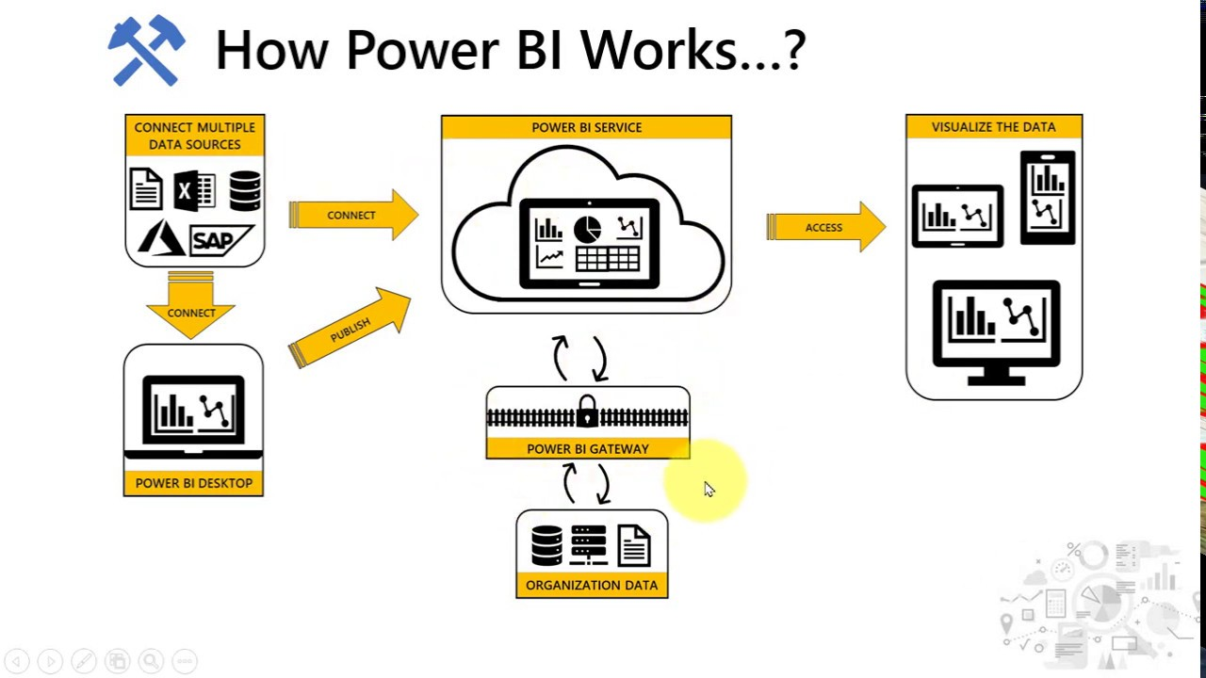
ARCHITECTURE

Slide 9
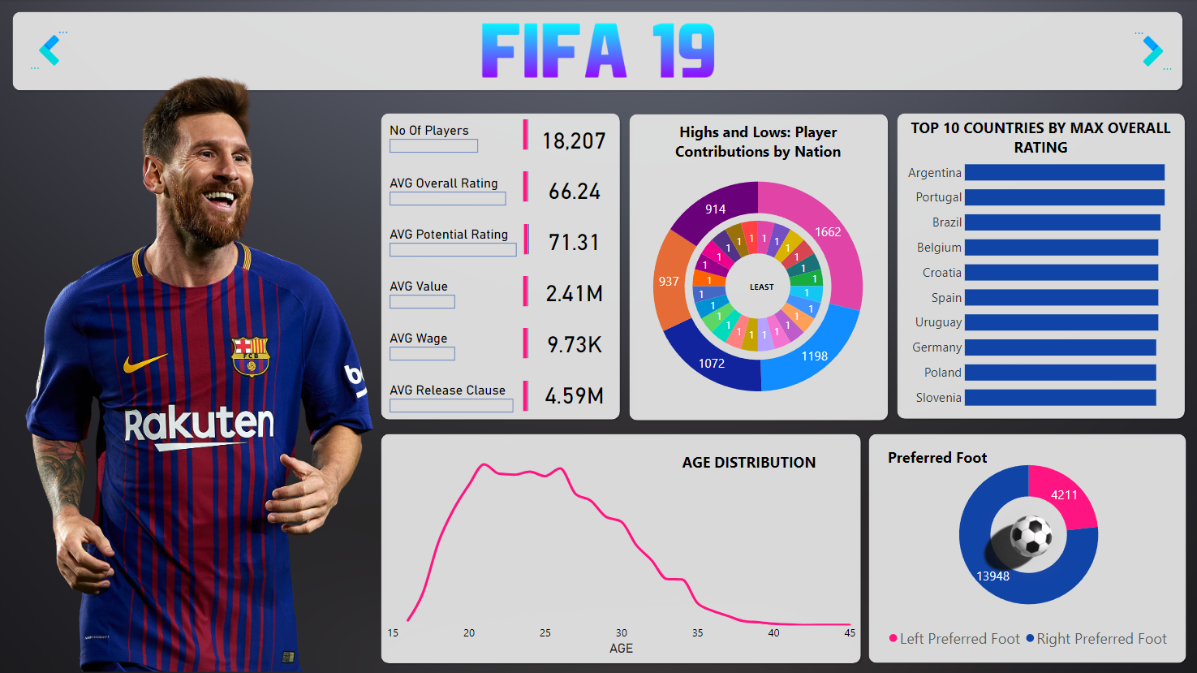
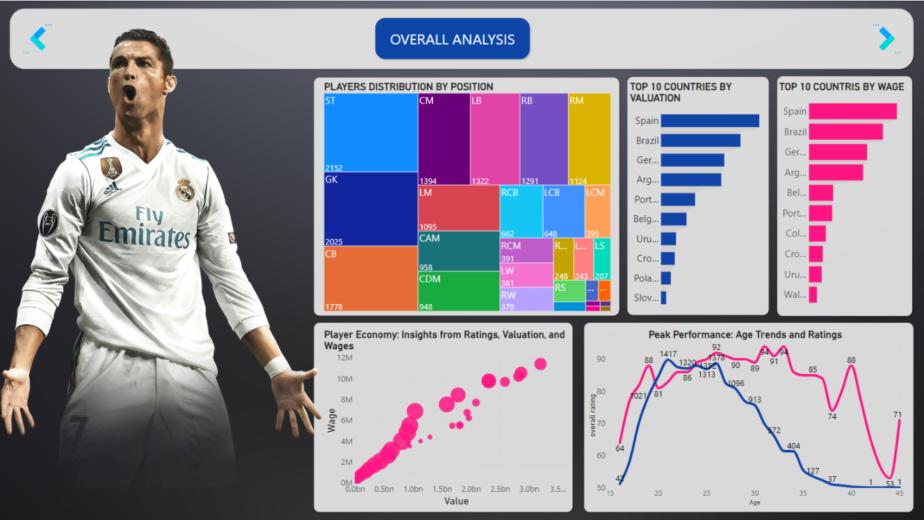
INSIGHTS:

Slide 10
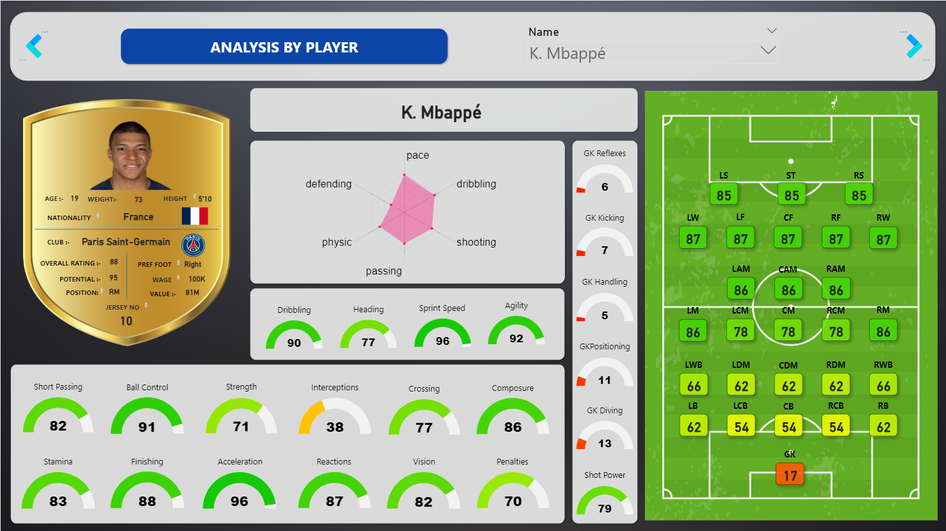
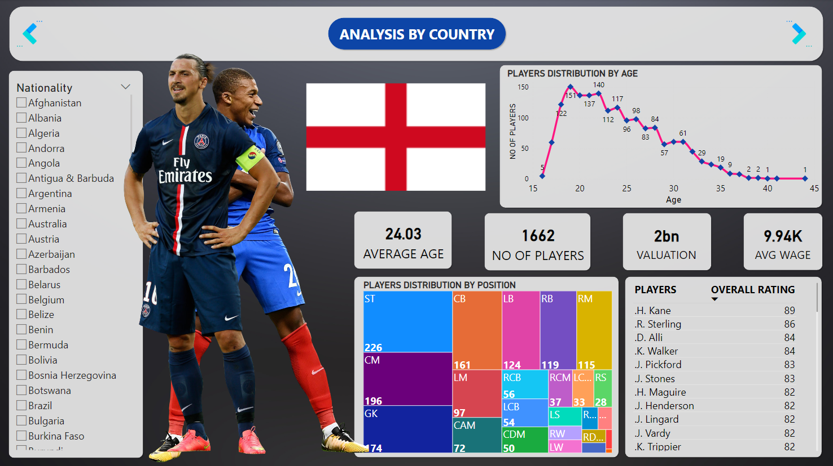
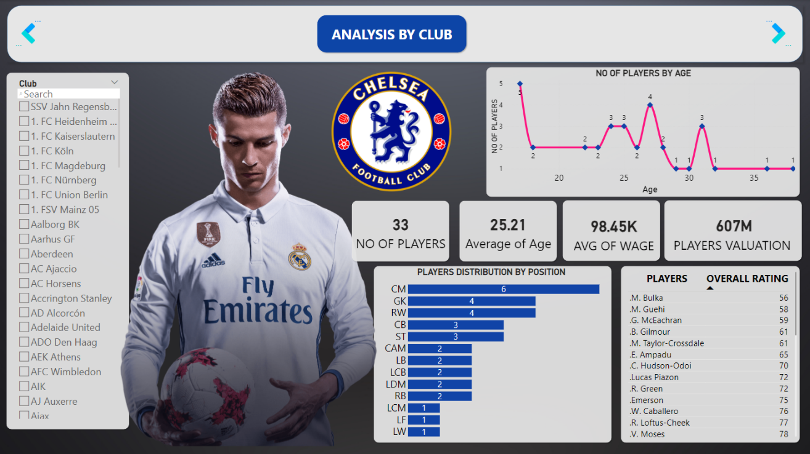

Slide 11
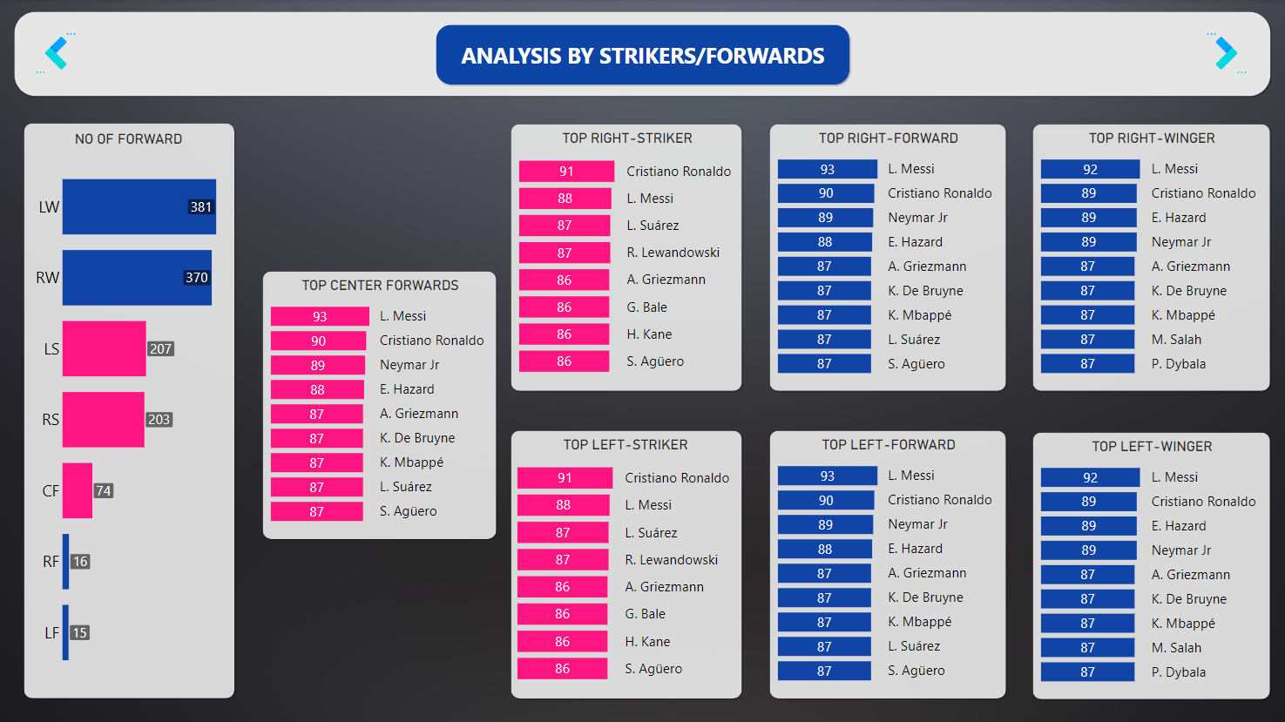
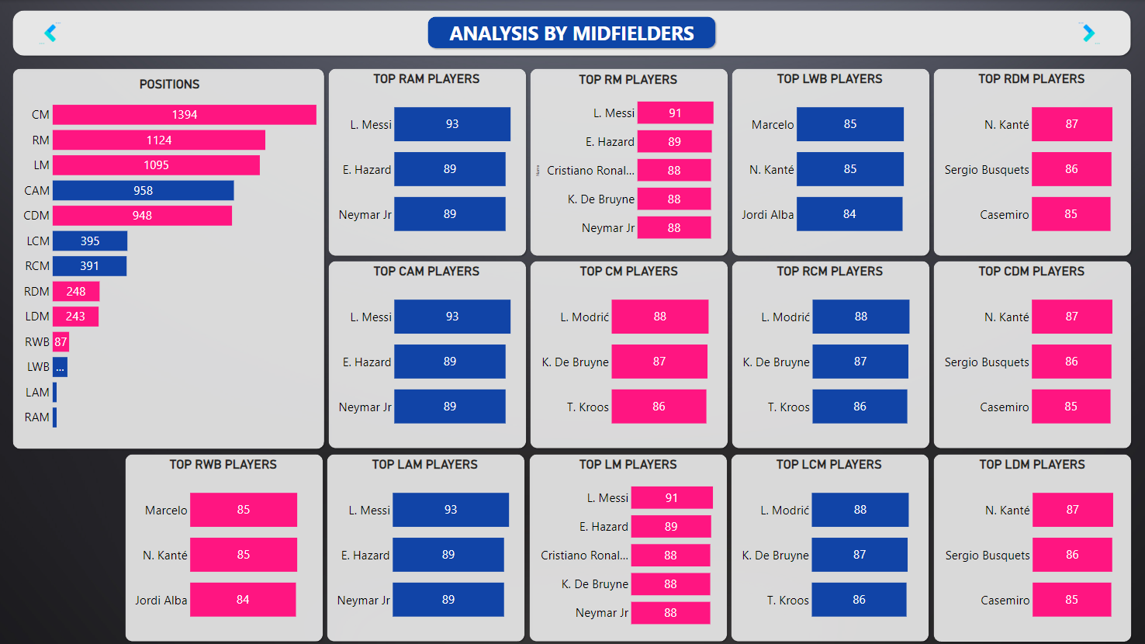
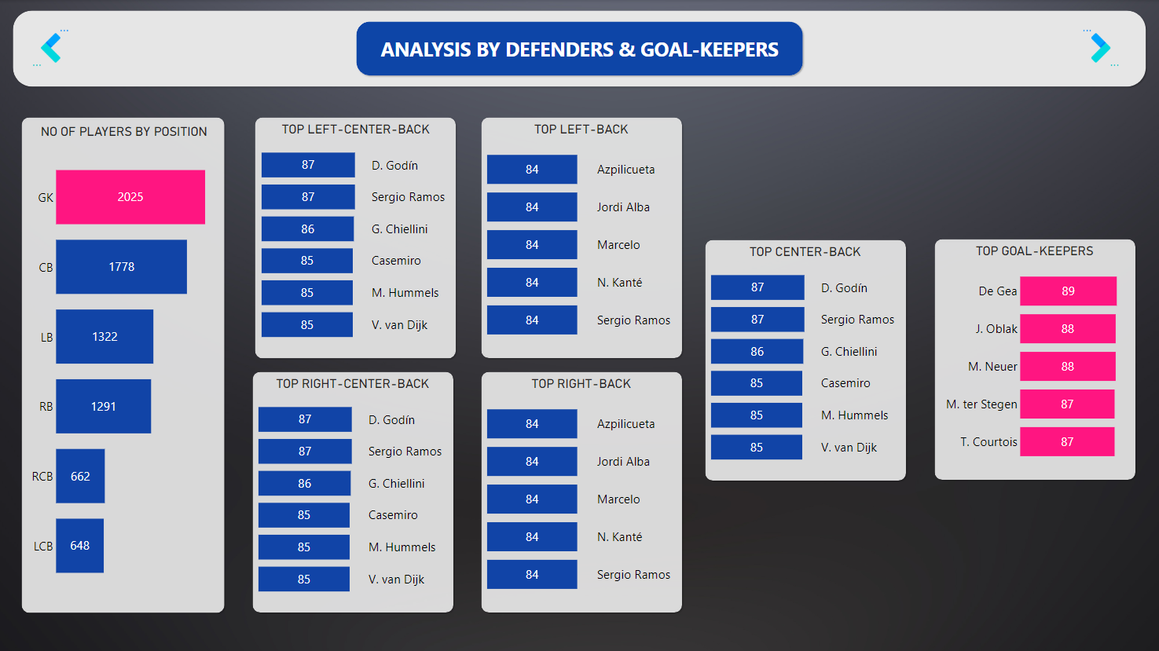

Slide 12
KPI'S:
Number of Players
Average Overall Rating
Average Potential Rating
Average Value
Average Wage
Average Release Clause

Slide 13
QUESTIONS:
Q1) What’s the source of data?
The dataset is taken from iNeuron.
Q2) What was the type of data?
The data was the combination of numerical and Categorical values.

Slide 14
Q 3) What techniques were you using for data pre-processing?
Removing unwanted attributes.
Visualizing relation of independent variables with each other and output variables.
Checking and changing Distribution of continuous values.
Removing outliers.
Replacing null values with 0.

Slide 15
Thank you

